Slide 1
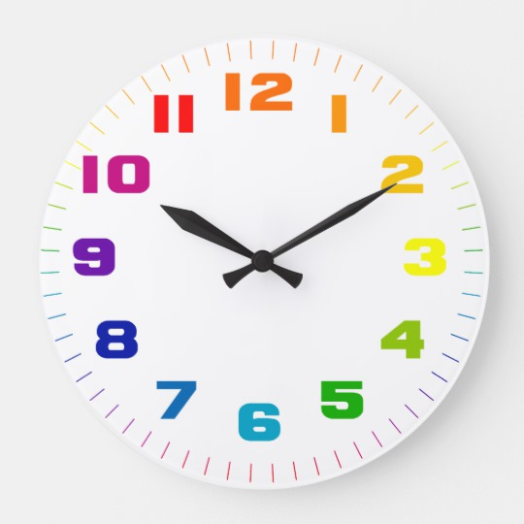
twelve
eleven
one
ten
two
nine
three
eight
four
seven
five
six

