Slide 1
snake

Slide 2
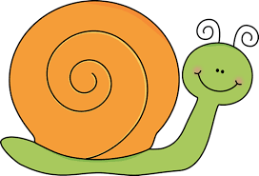
snail

Slide 3
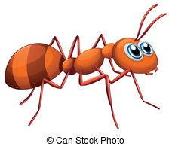
ant

Slide 4
angel fish

Slide 5
tiger

Slide 6
tortoise

Slide 7
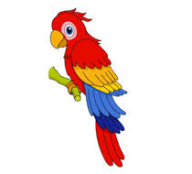
parrot

Slide 8
peacock

