Slide 2
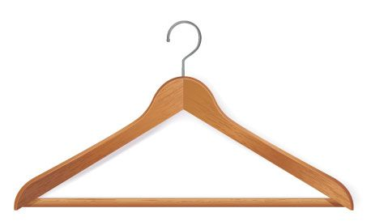
A triangle hanger.

Slide 4
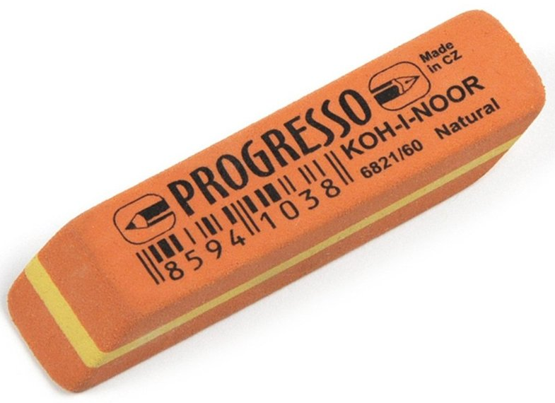
A parallelogram rubber.

Slide 6
A square cake.

Slide 8
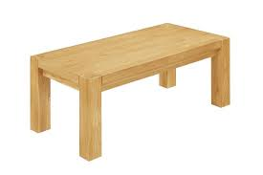
A rectangle table.

Slide 10
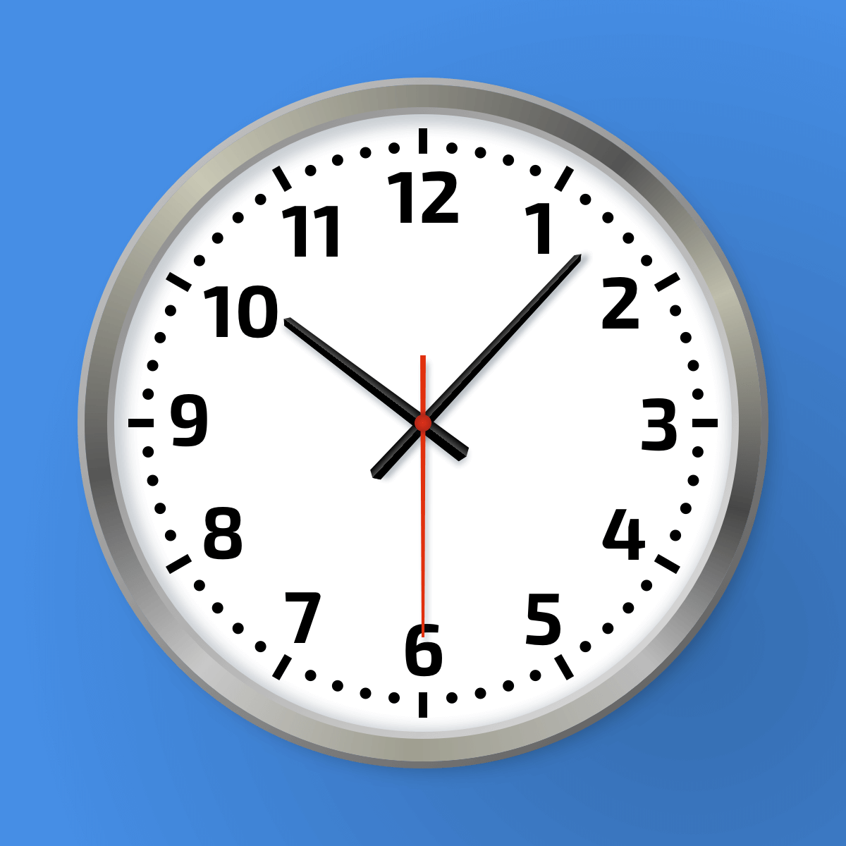
A circle clock.

